Slide 1
The Effect of Covid-19 on Unemployment
Emily Dinh, Ryan Wallace, Maura Keith

Slide 2
Introduction
Covid-19 has severely impacted the US economy
Our goal: To understand exactly how the Covid-19 pandemic has affected the US economy

Slide 3
Introduction
Specifically, we looked at the relationship between Covid-19 cases and weekly initial unemployment claims
Weekly initial unemployment claims represent the number of people that have newly filed for unemployment benefits that week
Initial unemployment claims is a strong indicator of how well the economy is performing
By understanding the relationship between Covid-19 and initial unemployment claims, we will also be able to understand how Covid-19 is affecting the economy

Slide 4
Introduction
We would also like to be able to predict weekly initial unemployment claims based on Covid-19 data
Confirmed cases
Active cases
Recovered Cases
Deaths
Incidence rate
Being able to predict initial unemployment claims will be helpful in predicting when the economy will begin to recover

Slide 5
Introduction
Through this project, we aim to answer the following questions
What is the relationship between Covid-19 and unemployment in the United States?
Does a higher rate of Covid-19 cases lead to more initial unemployment claims?
Does a higher case-fatality ratio lead to more initial unemployment claims?
Does a higher rate of Covid-19 recoveries lead to fewer initial unemployment claims?
Which machine learning regression algorithm is able to best predict initial unemployment claims based on Covid-19 cases?

Slide 6
Data
After data wrangling, one-hot encoding, and feature selection our dataset contained the following columns:
Confirmed cases
Deaths
Recovered cases
Active cases
Incidence rate
Case fatality ratio
Selected states
Initial weekly unemployment claims

Slide 7
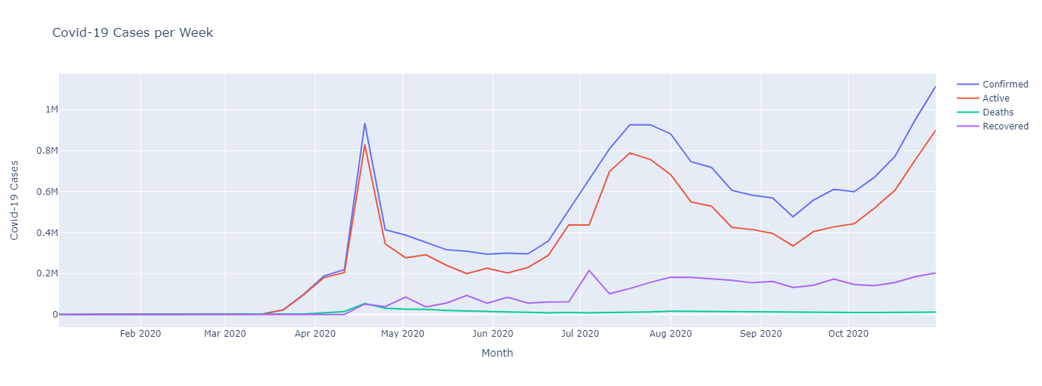
Data

Slide 8
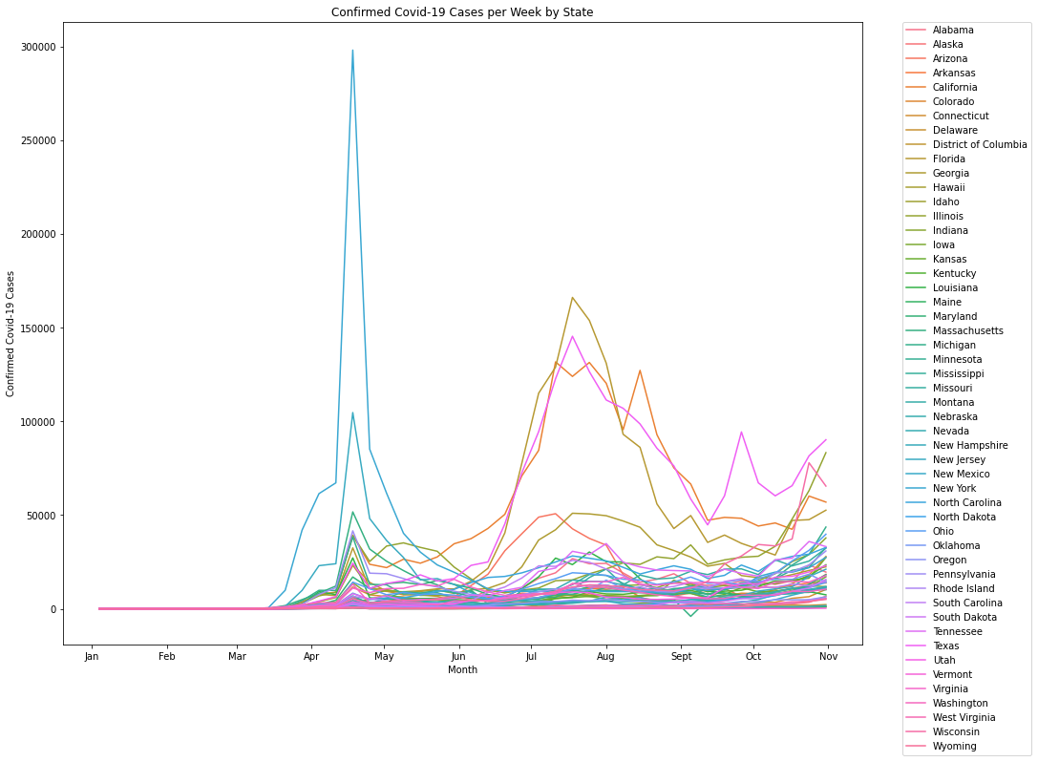
Data

Slide 9
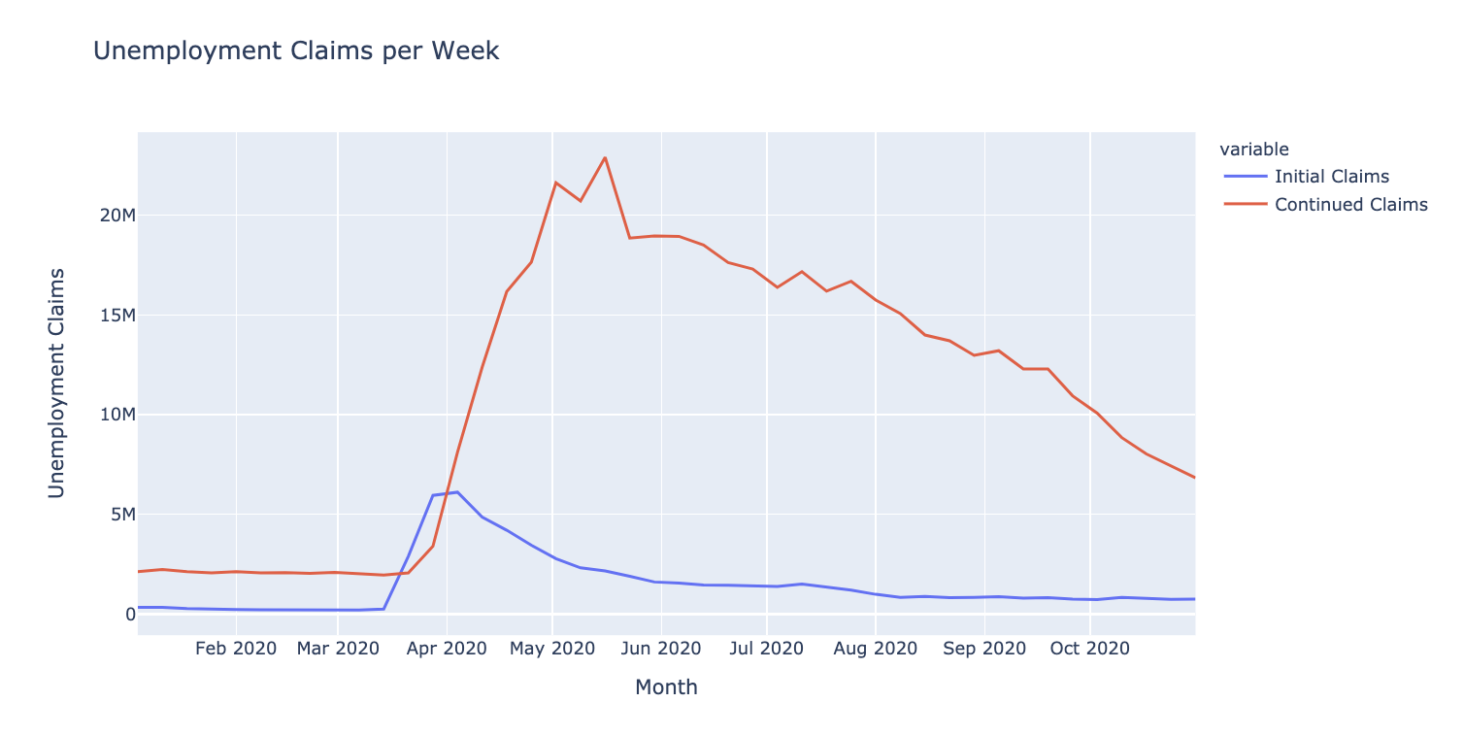
Data

Slide 10
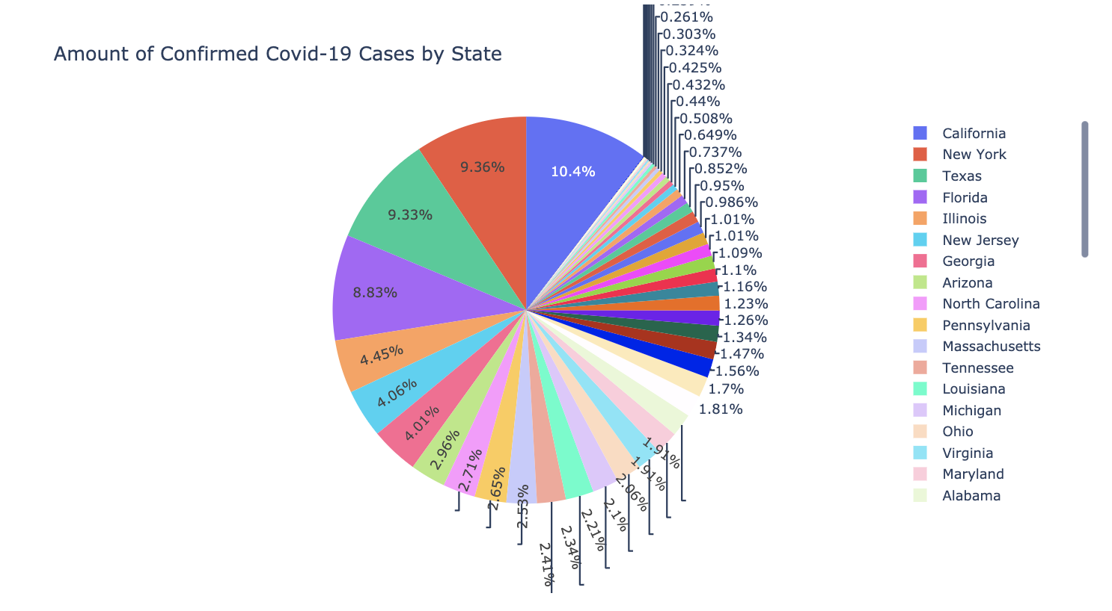
Data

Slide 11
Results
We constructed and tuned four ML regression models to predict initial weekly unemployment claims
Ridge regression
LASSO regression
kNN regression
SVM regression
We also conducted an OLS Regression Hypothesis Test to see the relationship with all our selected Covid data features and initial claims

Slide 12
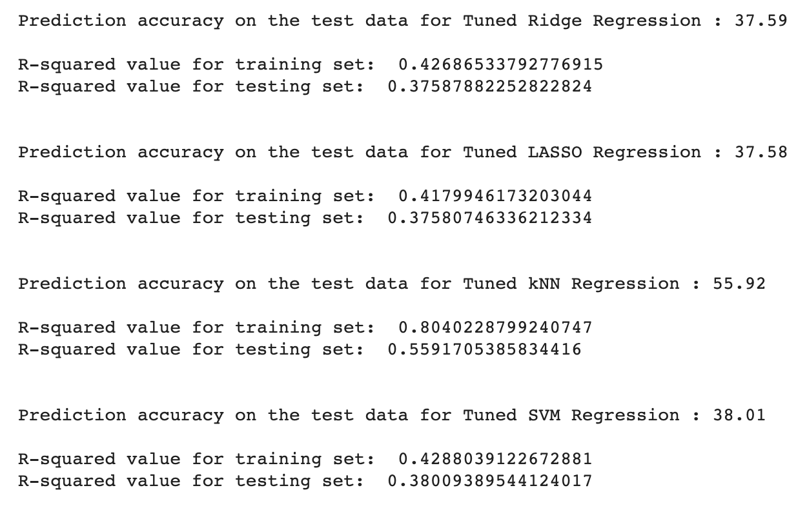
Results

Slide 13
Discussion
We found that the kNN regression model had the best performance with about 55.9% accuracy
However, it also had the most overfitting between training/testing set R² values
22 of our 30 selected features had statistically significant relationships at the 99% confidence level with initial unemployment claims

Slide 14
Discussion
Our analysis was hindered by several limitations
Covid data was only non-zero starting in March, but our timeline starting January 1 (Not the same with initial claims)
Monthly unemployment rate data we wished to use would not have produced a large enough dataset for our ML task
Feature selection had a negative impact on the overall performance of our four ML models

Slide 15
Discussion
In the future, continuing to analyze the impact of Covid-19 on unemployment and the economy as a whole will be crucial
Using ML algorithms to discern this effect could help shape economic policy, possibly for years to come

